Slide 1


IBM DATA ANALYTICS -
HR ATTRITION PROJECT PRESENTATION
PRESENTED BY:
RISHABH KUMAR

Slide 2


TABLE OF CONTENTS
Summary of Project.
KPI List.
EXCEL Dashboard.
POWER BI Dashboard.
Tableau Dashboard.
SQL Queries.
Conclusion.
Key Insights.

Slide 3

SUMMARY OF THE PROJECT
The HR Attrition dataset includes information on employees such as age, department, job role, income, education, experience, performance, and attrition rate. It assists in analyzing variables that influence employee turnover, identifying high-risk groups, and implementing data-driven HR solutions to increase retention, employee satisfaction, workforce planning, and organizational performance.

Slide 4

KPI LIST
Total Employees.
Attrition Count.
Attrition Rate.
Active Employees.
Average Age.
Average Income.
Average Working Years.
Attrition by Department.
Attrition by Education field.
Attrition by Job Satisfaction.

Slide 5

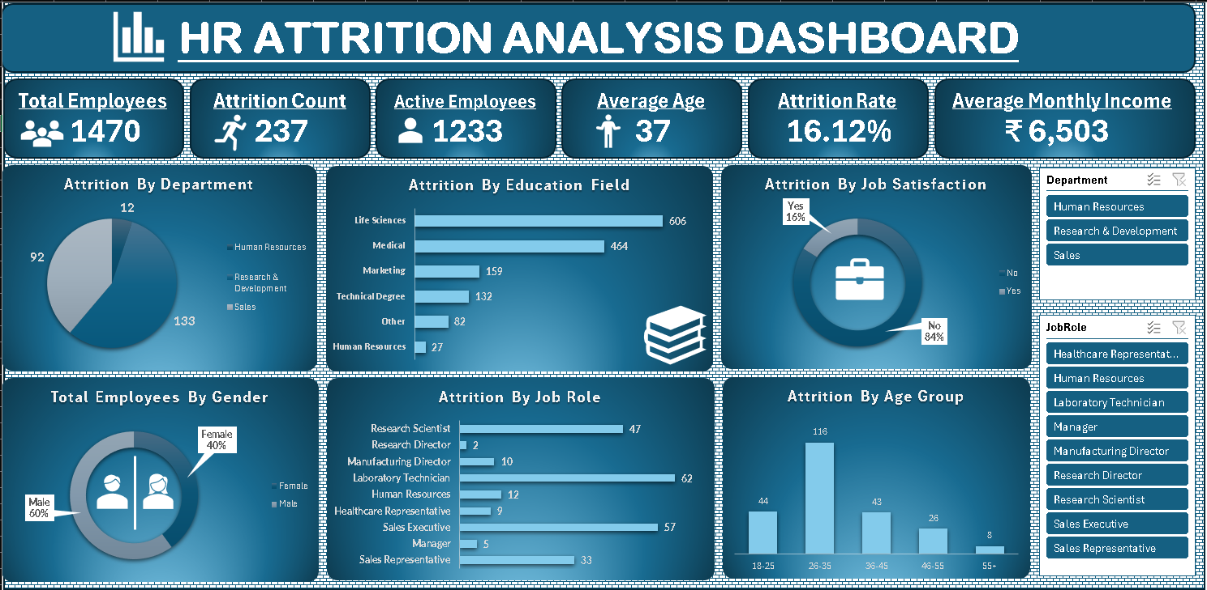
EXCEL DASHBOARD

Slide 6

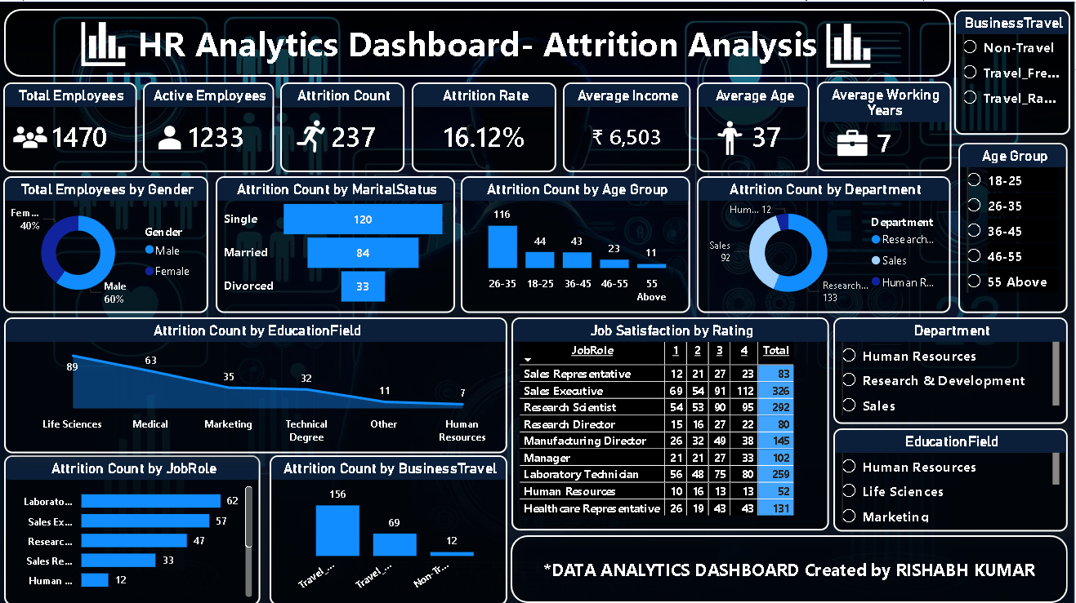
POWER BI DASHBOARD

Slide 7

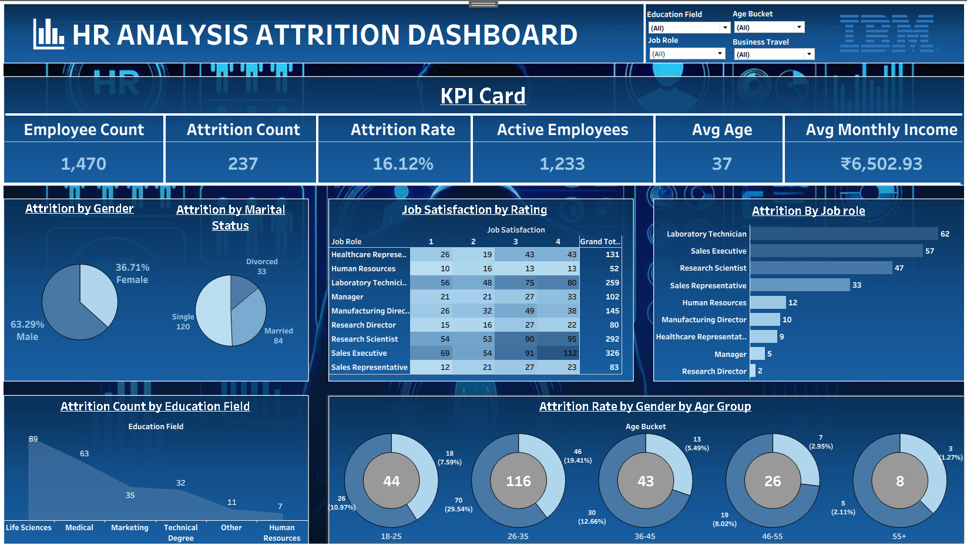
TABLEAU DASHBOARD

Slide 8

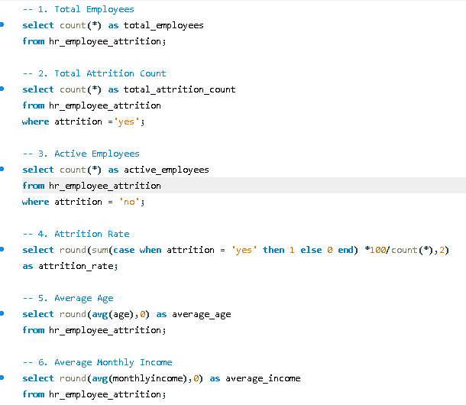
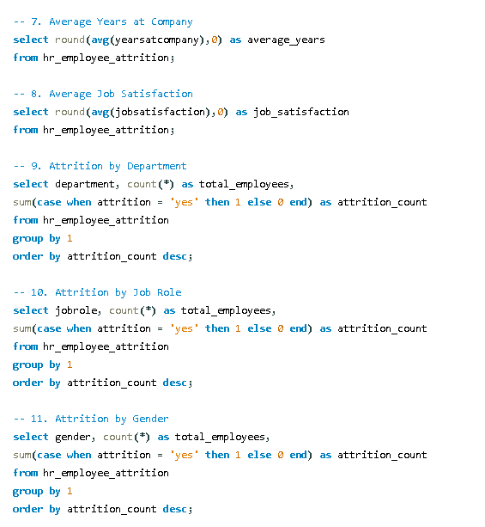
SQL QUERIES

Slide 9

KEY INSIGHTS
The HR Attrition Dashboard shows an overall attrition rate of about 16%, with employees aged 26-35 seeing the highest turnover, notably in Sales and Laboratory Technician jobs. Employees with lesser pay, frequent overtime, and shorter tenure are more likely to depart.
Single employees exhibit higher attrition than married employees, although job satisfaction and work-life balance have a significant influence on retention. These insights assist HR in identifying high-risk employee categories and implementing focused efforts to increase engagement, lower attrition, and boost workforce stability.

Slide 10

CONCLUSION
By displaying important variables including age, department, job function, pay, education, and years of service, the HR Attrition Dashboard offers insightful information about employee turnover. The study shows trends that may be used to pinpoint high-risk employee demographics and the main causes of attrition. In the end, these insights lower attrition and promote long-term organizational development and productivity by empowering HR teams to make data-driven choices, boost employee engagement, improve retention tactics, and optimize workforce planning.

Slide 11

THANK YOU

